Slide 1
DIFFERENT LEVELS OF TESTING

Slide 2
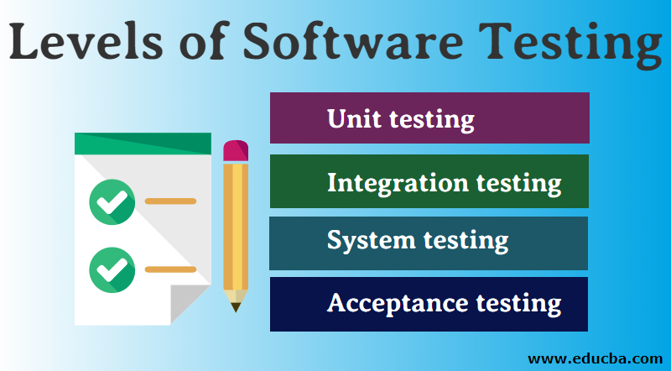

Slide 3
UNIT TESTING
It involves the testing of each unit or an individual component of the software application.
It is the first level of functional testing.
The purpose of unit testing is to test the correctness of isolated code
Whenever the application is ready and given to the Test engineer.
They will start checking every component of the module or module of the application independently or one by one.
It helps testers and developers to understand to fix bugs early in the development cycle and save cost
White box testing approach
Done by the developers.
Helps in the documentation.
It helps with code reusability and migrate both code and test.
To understand correctness code and enable to make changes quickly.

Slide 4
INTEGRATION TESTING
It is a second level of software testing process
All modules may be coded by the different programmers or developers.
Tester integrating various components or modules of an application and testing their behavior as a single unit or group
It also known as thread testing or string testing.
It is mainly to check correctness and communication among all modules.
To check the integration of software modules with the database whether it is correct or not

Slide 5
SYSTEM TESTING
It validate the complete and fully integrated software product.
It evaluate the end to end system specifications
It is a type of black box testing
It perform quality assurance team in testing face
It focus on functionality, accuracy, quality, expected output, overall behavior of an application rather than the inner working of systems.
It improved product quality
Customer satisfication.
Error reduction.

Slide 6
ACCEPTANCE TESTING
Final level of software testing.
Black box testing
Performed by end user or client
The application to find out if the software meets the user expectations and works as expected.
It performed on user environment.
It is also called UAT,FAT,RBT.
Customer test that a particular product develop as per the customer requirement, customer expectation, customer need . So this called acceptance testing.
It focus on expected product of customer.

